Slide 1
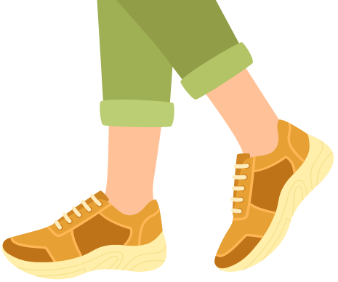
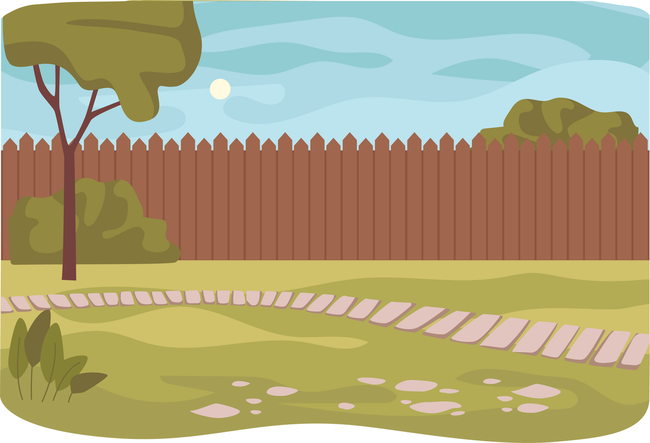
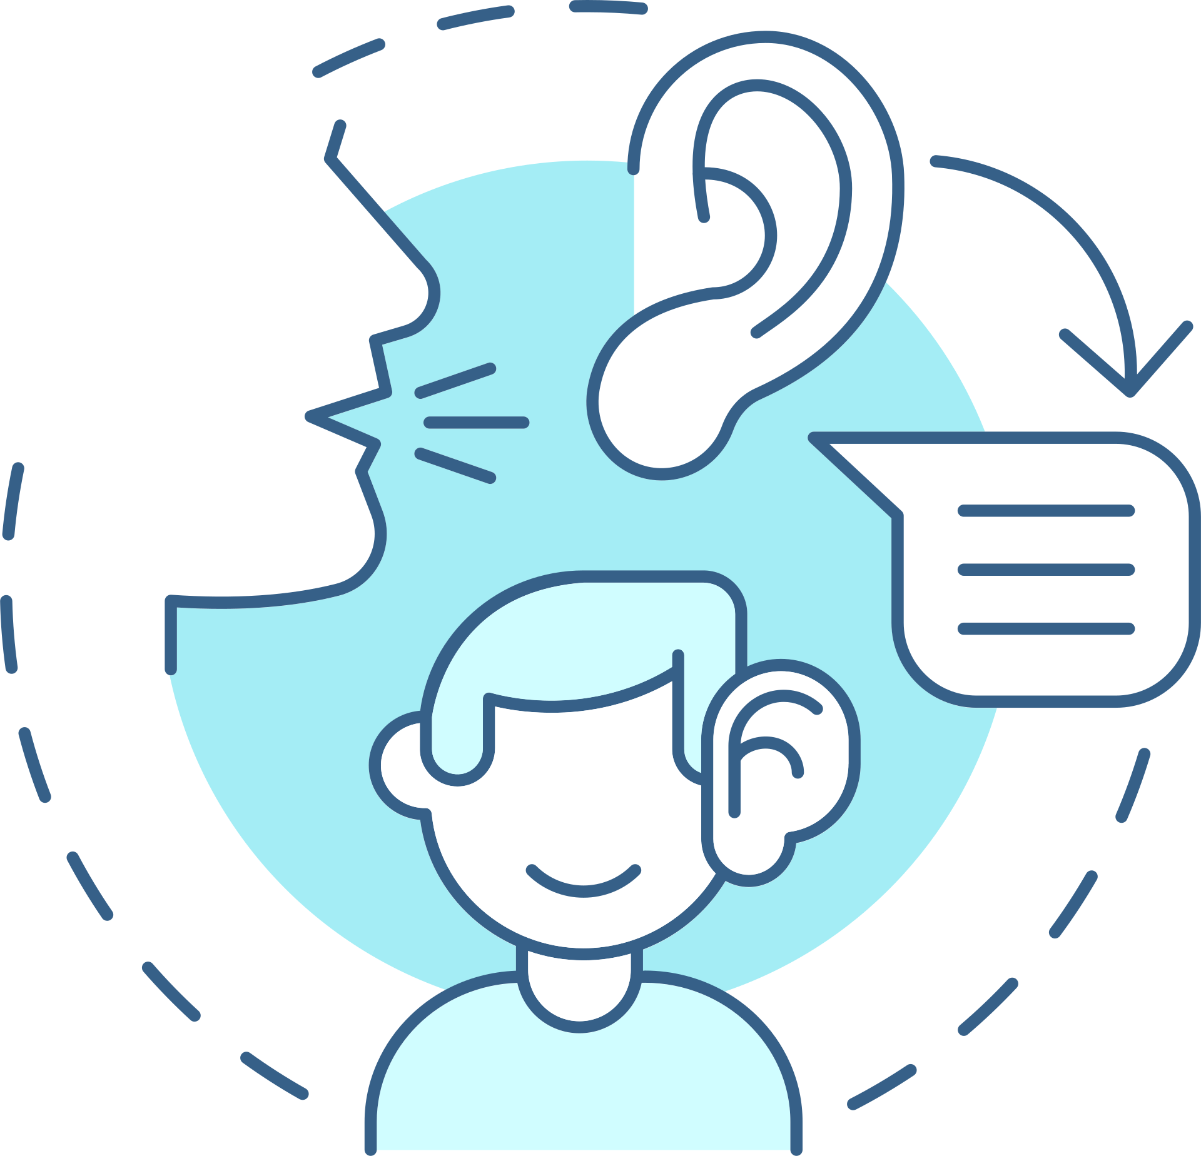
Teachers to use fewer words when speaking to me about my behaviour/learning/ instructions. | Be able to walk around the classroom when I feel restless. | Have work breaks/movement breaks multiple times in each lesson. | Be able to get fresh air during my movement breaks.
Have a card I can use to let the teacher know I need help. | Sit next to someone quiet who is good at listening to the teacher. | Have a token system on my desk for my teacher to add to when I am on task. | Have a daily visual tracker that shows me my positive behaviours and how my behaviour is improving over time.

Slide 2
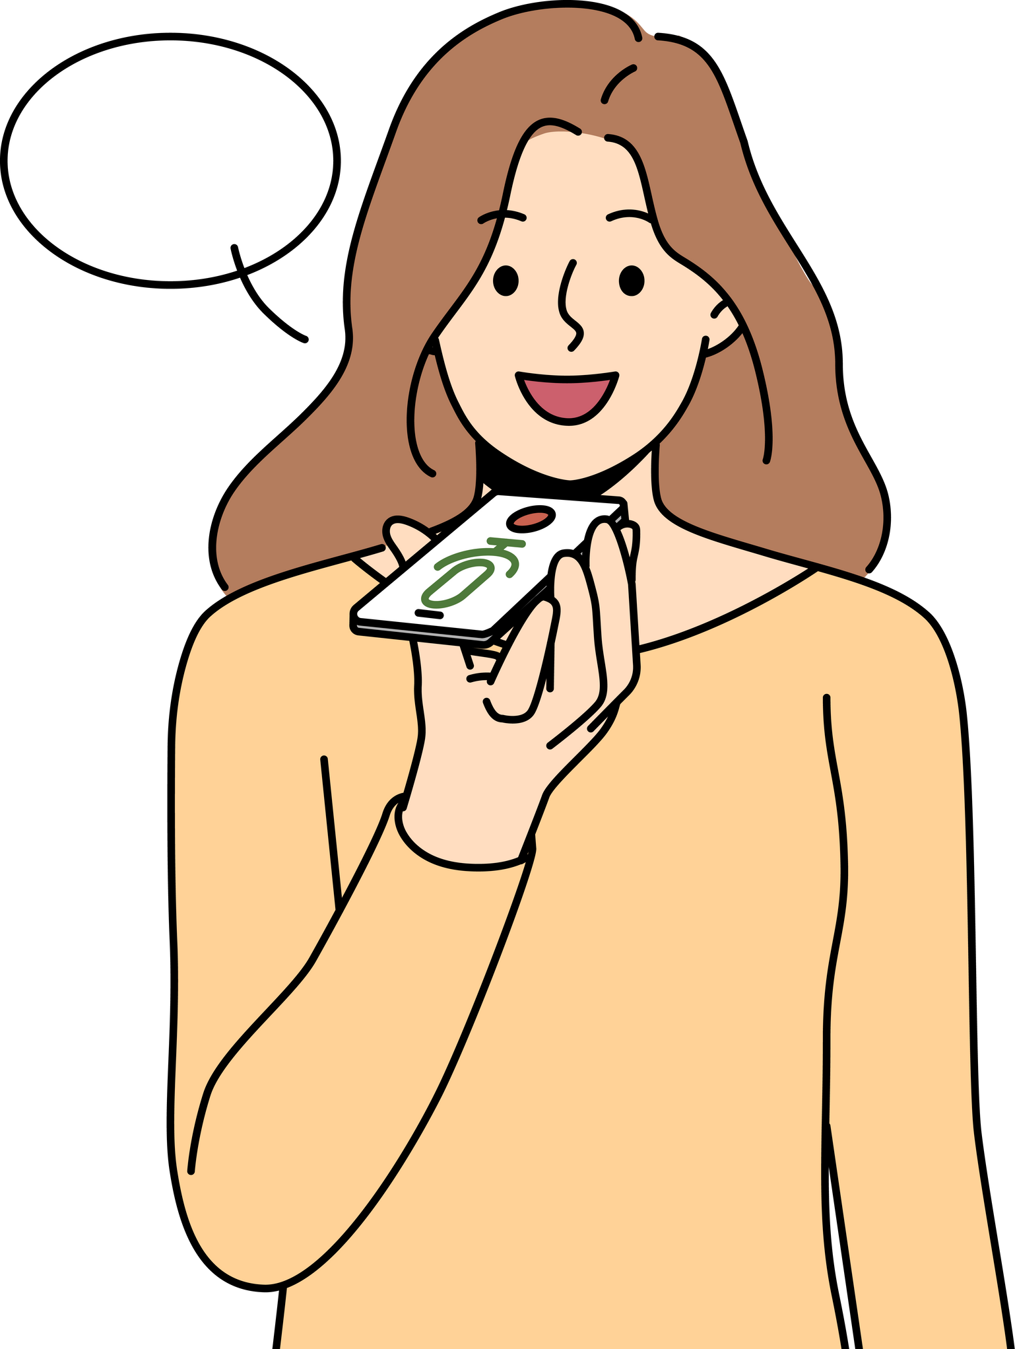
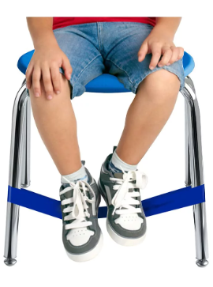
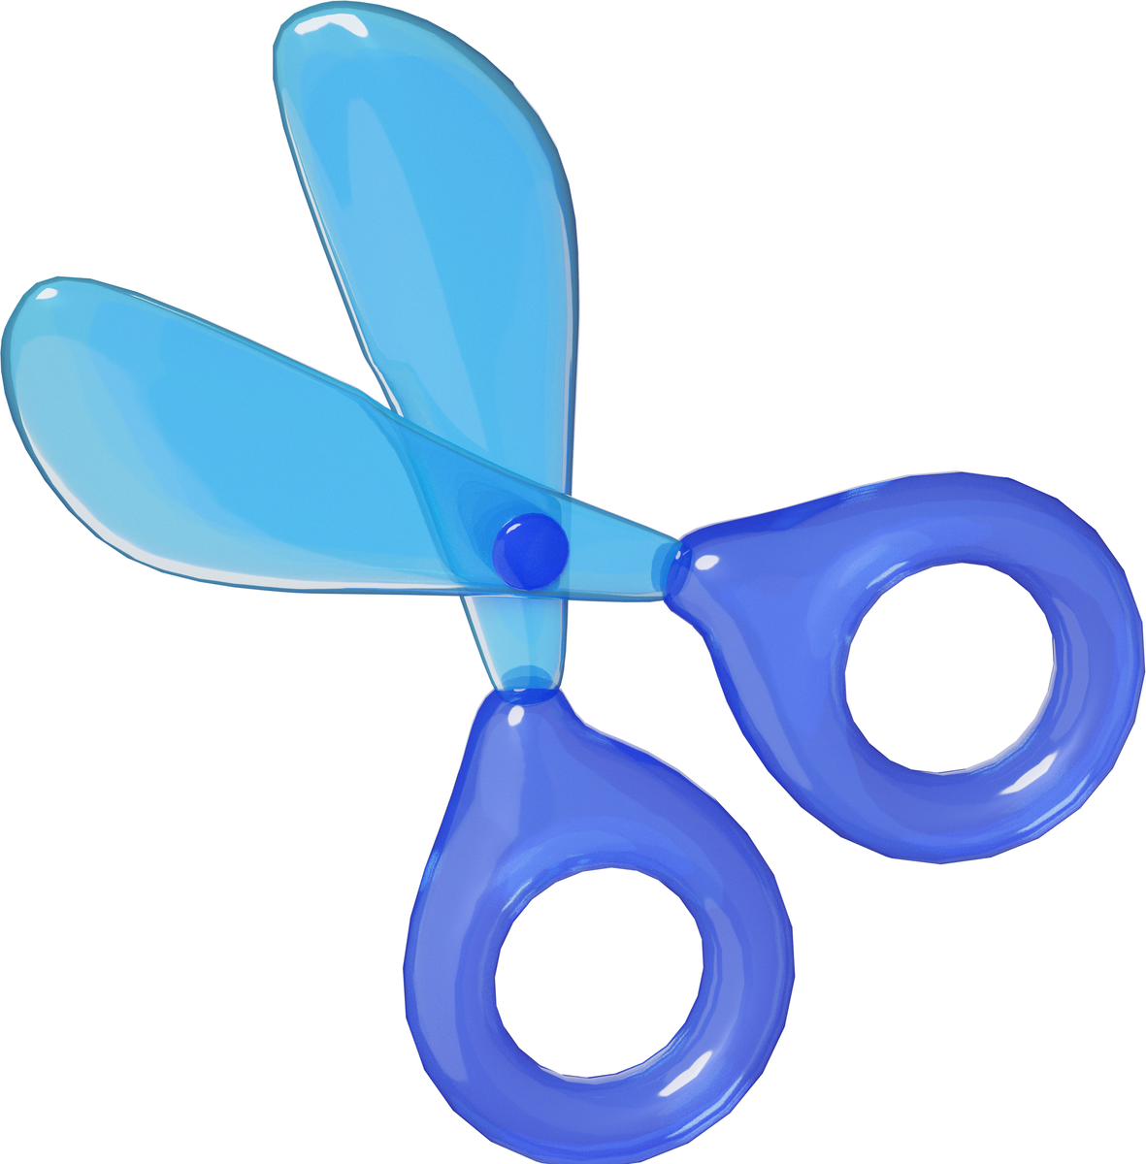
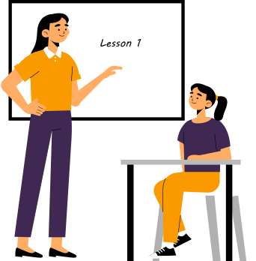
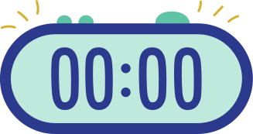
Extra reminders set on my phone of the deadlines for assignments. | Sitting on a chair where I could get more sensory feedback (e.g. wobble cushion, resistance band round legs, spinning chair). | Be able to use a hands-on concentration aid/object at my desk while I listen to the teacher. | Use voice-recording button to record ideas while I write.
Have longer bits of writing cut up into shorter passages for ease of reading. | Rate my learning out of ten at the end of each school day. | Have the teacher ask me to recite a shorter version of the classroom rules before I start the lesson to remind me. | Have a timer on my desk to tell me how long I have until break or the end of the task/lesson.

Slide 3
CONNECT
MOVEMENT
CHOICE
PRAISE
Reminders are the intervention – needing to repeat yourself is not a sign of defiance, expect them to forget the task
Connection before correction – play, humour, touch, calm nervous system and reengage thinking brain
Sensory seeking expected and catered for – integrate into the learning
Choose topics to suit them -give them choices, it is easier to concentrate on topics of interest
Reduce the words – short, to the point, simple, repeat instructions
Have reasonable expectations – frequent praise for skills they do have, adapt certain parts of the day, utilise Zone of Proximal Development
PROMPT
SIMPLE

